Slide 1
Operating system
Banker’s Algorithm

Slide 2
Group Members
Ahmed Ezzat Kamel Solomon 20172046
Mohamed Raouf Ahmed Mohamed 20172043
Mohamed Essam Mohamed Salama 20132232

Slide 3
Introduction
The Banker algorithm, sometimes referred to as the detection algorithm, is a resource allocation and deadlock avoidance that tests for safety by simulating the allocation of predetermined maximum possible amounts of all resources, and then makes an "s-state" check to test for possible deadlock conditions for all other pending activities, before deciding whether allocation should be allowed to continue.

Slide 4
Resources
For the Banker's algorithm to work, it needs to know three things
How much of each resource each process could possibly request[MAX]
How much of each resource each process is currently holding[ALLOCATED]
How much of each resource the system currently has available[AVAILABLE]
Resources may be allocated to a process only if the amount of resources requested is less than or equal to the amount available; otherwise, the process waits until resources are available.

Slide 5
Data Structures
Available: A list holding current available resources in the system
Allocation : A 2D list holding current allocated resources for each process
MAX: A 2D list holding Maximum demand for each process
Need: A 2D list holding the required resources for each process to run
Need[i,j] = Max[i,j] - Allocation[i,j]

Slide 6
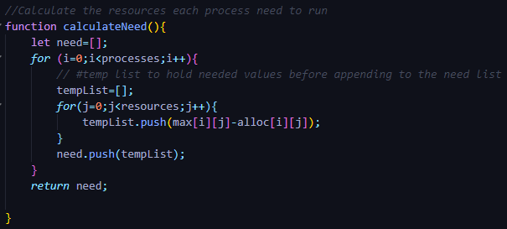
Function created to calculate the needed resources for each process and returns it in a 2D list
Loops through each Process and calculate the needed resources by subtracting the maximum from the allocation
Need[i][j]=Max[i][j]-Alloc[i][j]

Slide 7
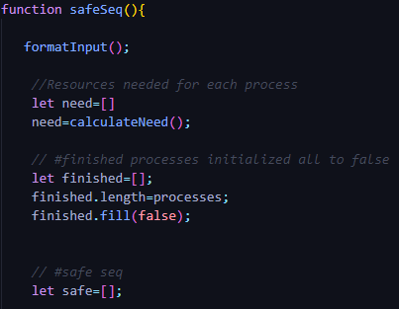
Function to determine the safe sequence
Need[] list to hold the needed values returned from the Calculate need function
Finished[] list initialized to all false to determine which processes have finished and don’t need resources anymore
Empty Safe[] list to hold the safe sequence when it’s determined

Slide 8
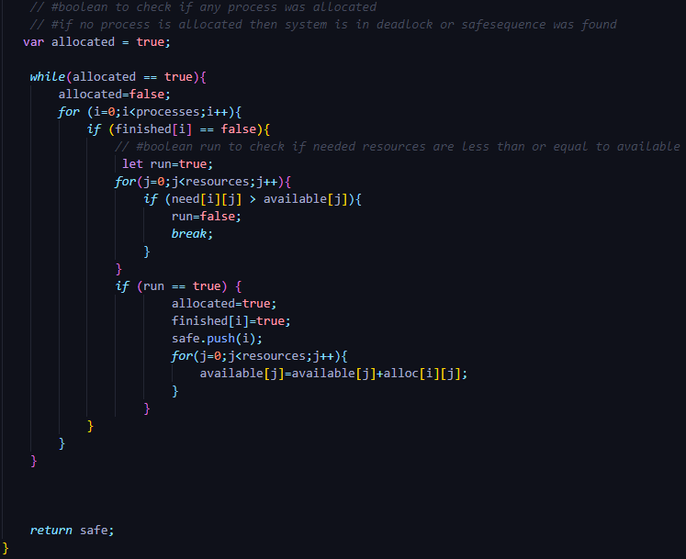
Variable allocated to check if any process was allocated or not
While loop runs until no process is allocated
For loops on all processes
If(finished[]) determines if the process is finished or not if it’s finished no action is taken
If not a variable true is set to true and we loop on each resource of the process to check if Need if > than available
If true then process can’t run and is set to false and break out of loop
If false run ,allocated and finished are set to true and the process is pushed into the safe sequence list and it’s allocated resources are added into the available resources in the system

Slide 9
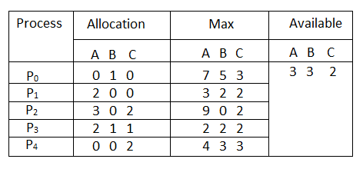
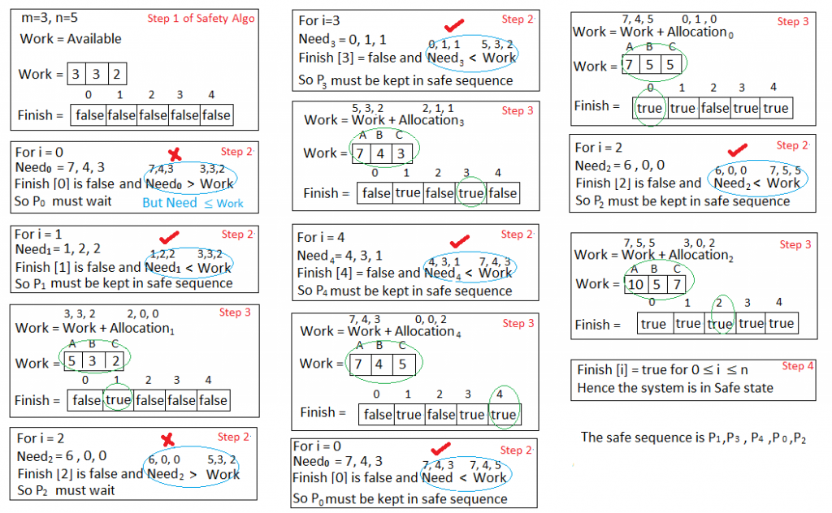
Example
Safe sequence is P1,P3,P4,P0,P2

Slide 10
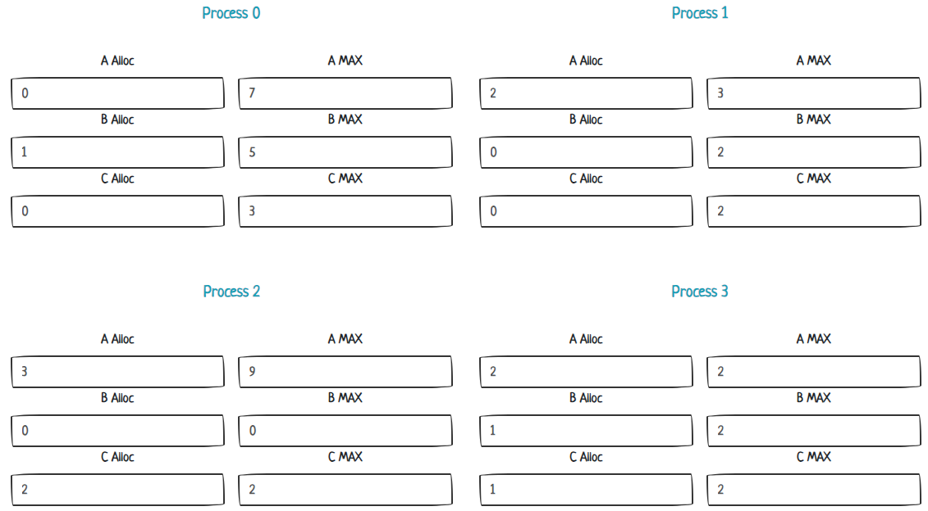
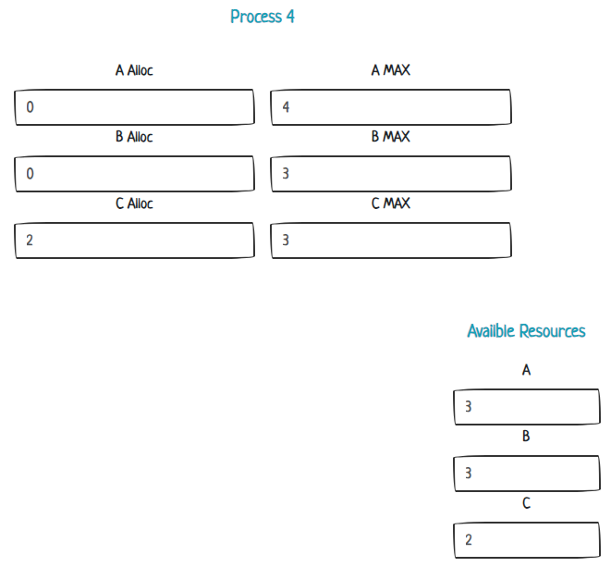
Code input

Slide 11
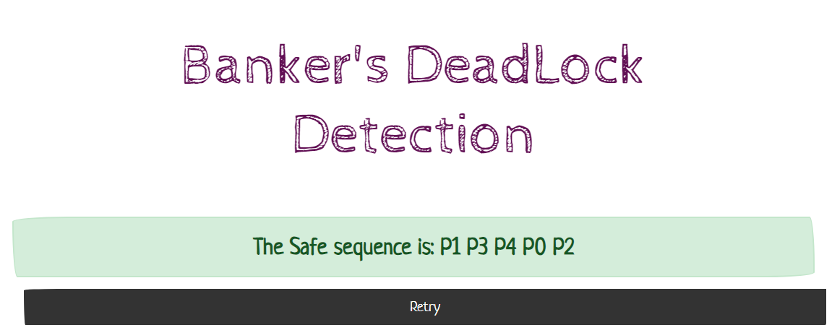
Code output

Slide 12
Project website and GitHub repository
Project Code is included with the presentation
Git repository link : https://github.com/Testingoutbtw/Bankers
Project is hosted on : https://testingoutbtw.github.io/Bankers/

